Slide 1
INDIVIDUAL HOMEWORK
cANCescu mihai

Slide 2
Problem Statement
Write all the anti-models of the propositional formula U2 = (p ∧ q ) ∧ ¬ r → p ∧ q ∧ r using the semantic
tableaux method

Slide 3
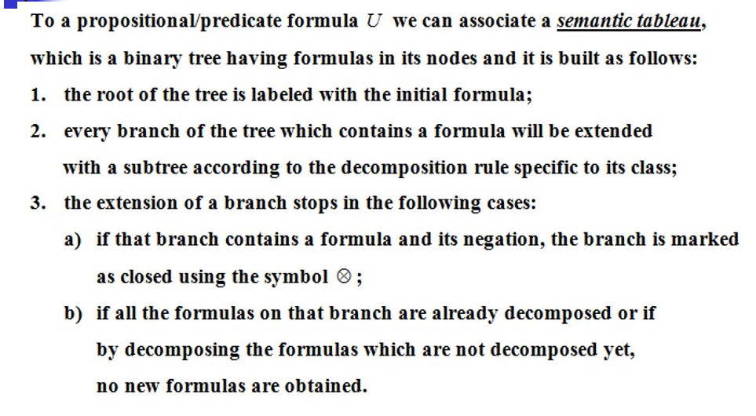
How to build it?

Slide 4
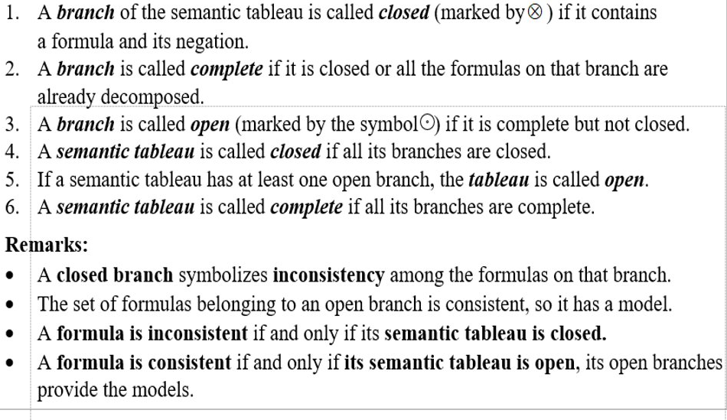
Definitions

Slide 5
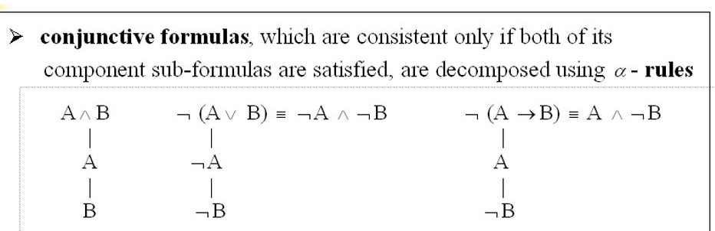
Conjunctive formulas

Slide 6
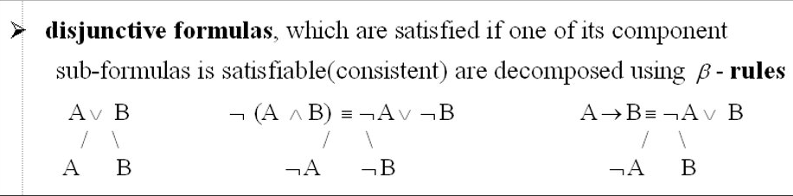
Disjunctive formulas

Slide 7
Disjunctive formulas

Slide 8
P Q R │ ((P ∧ Q) ∧ ¬R) → ((P ∧ Q) ∧ R) ───────┼──────────────────────────────── 1 1 1 │ 1 0 0 1 1 1 1 1 0 │ 1 1 1 0 1 0 1 0 1 │ 0 0 0 1 0 0 1 0 0 │ 0 0 1 1 0 0 0 1 1 │ 0 0 0 1 0 0 0 1 0 │ 0 0 1 1 0 0 0 0 1 │ 0 0 0 1 0 0 0 0 0 │ 0 0 1 1 0 0

Slide 9
¬(((p ∧ q ) ∧ ¬ r) → p ∧( q ∧ r) )
Initial formula
α rule
(p ∧ q) ∧ ¬ r
closed
¬(p ∧ (q ∧ r) )
closed
p ∧ q
¬r
β rule
¬p
¬(q^r)
p
¬p
p
q
¬r

Slide 10
P Q R (¬R ∧ P) ∧ Q
1 1 1 0 0 0
1 1 0 1 1 1
1 0 1 0 0 0
1 0 0 1 1 0
0 1 1 0 0 0
0 1 0 1 0 0
0 0 1 0 0 0
0 0 0 1 0 0
Counter model of U:
p:true
q:true
r:false

